Slide 1
Computation Offloading or Cyber Foraging in Smartphones
Aditya Khune
Masters student, Electrical and Computer Engineering,
Colorado State University

Slide 2
Overview
Motivation behind Offloading the Smartphone Computation on Cloud
Computation Offloading Architecture
Related work
Applications benefitting from Computation Offloading
Challenges in Offloading
Methodologies: Fuzzy Logic Decision Engine, Reinforcement learning based engine
Conclusion

Slide 3
Basic approaches to saving energy and extending battery lifetime in mobile devices
Low-power design has been an active research topic for many years
Adopt a new generation of semiconductor technology
Avoid wasting energy : Whole systems or individual components may enter standby or sleep modes to save power.
Execute programs slowly : Play with the Clock Speed, reduced speed for less energy consumption.
Offloading to Eliminate computation all together : The mobile system does not perform the computation; instead, computation is performed somewhere else, thereby extending the mobile system’s battery lifetime.

Slide 4

Server
Code Offloading:
Code Partitioning:
- Static Annotations ( e.g. @offloadable)
- Runtime with Automated mechanism
C
public class Foo {
void method1( ) {
//……
}
void method2( ) {
//Offloading Candidate
}
void method3( ) {
//……
}
main( ) {
method1( );
method2( );
method3( );
}
}
Synchronization Point
Transfer
ratio
OC
Local
Processing
OC
Remote
Processing
Invocation
Transfer
ratio
Synchronization Point
C
OC – Offloading Candidate
Method, Thread, or Class
Execution
flow

Slide 5
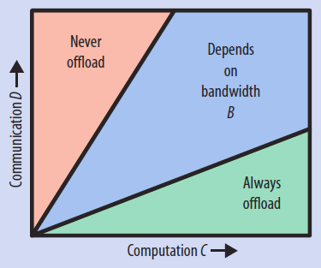
Energy Analysis of Computation Offloading:
The amount of energy saved is: Pc × (C/M) - [Pi × (C/S)] - [Ptr × (D/B)] Suppose the server is F times faster—that is, S = F × MThe amount of energy saved is: C/M×[Pc−Pi/F]−Ptr×D/B
The values of M, Pi, Pc, and Pth are parameters specific to the mobile system. For example, an HP iPAQ PDA with a 400-MHz (M = 400) Intel XScale processor has the following values: Pc ≈ 0.9 W, Pi ≈ 0.3 W, and Ptr ≈ 1.3 W.
If we use a four-core server, with a clock speed of 3.2 GHz, the server speedup F may be given by (S/M) ≈ [(3.2 × 1,024 × 4 × X)/400], where X is the speedup due to additional memory, more aggressive pipelining, and so forth. If we assume X = 5, we obtain the value of F ≈ 160. Now for offloading to break even:
C/400×[0.9−0.3/160]−1.3×D/B ≈ (0.00225×C)−1.3×D/B = 0
Bo ≈ 577.77×D/C
where Bo is the minimum bandwidth required for offloading to save energy,If (D/C) is low, then offloading can save energy.
C - The number of instructions required for a computation task
S - speed of the cloud server ( in instructions per
second )
M - speed of the Mobile System ( in instructions
per second )
One Task - takes C/S seconds on the server and C/M seconds on the mobile system
D - bytes of data exchanged between the server and mobile system
B - network bandwidth,
It takes D/B seconds to transmit and receive data.
Pc – The power consumed by the mobile system for computing (in watts,)
Pi - The power consumed by the mobile system while being idle,
Ptr - The power consumed by the mobile system for sending and receiving data.
The energy consumption:
If the mobile system performs the computation:
Pc × (C/M)
If the server performs the computation:
[Pi × (C/S)] + [Ptr × (D/B)]
K. Kumar and Y. H. Lu, “Cloud computing for mobile users: Can offloading computation save energy?," Computer, vol. 43, no. 4, pp. 51-56, 2010.

Slide 6
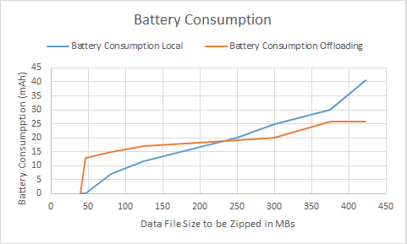
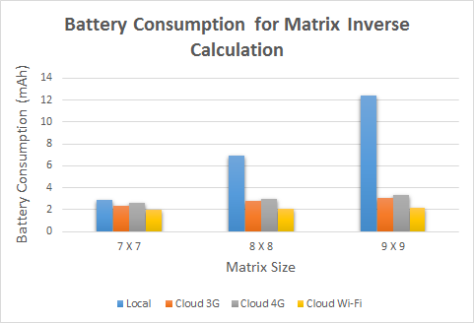
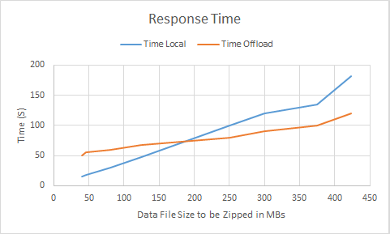
Applications benefitting from Offloading Framework
BitTorrent based file sharing: (For Downloading the files)
Matrix Calculator: (Calculating Inverse of a Matrix with Adjoint Method)
Zipper: (Compressing files)

Slide 7
Applications: Cloud Based Web Browsers
(Amazon Silk, Chrome Beta, Opera Mini, Puffin etc.)

Slide 8
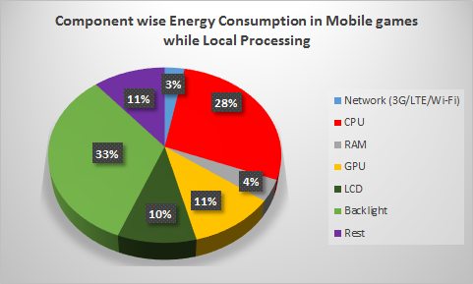
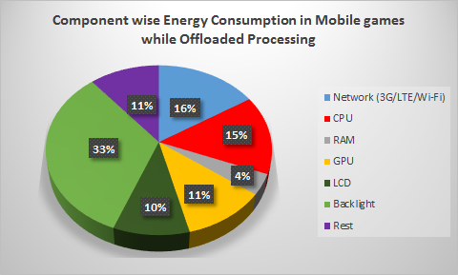
Applications: Cloud Based Mobile Gaming
(GamingAnywhere (Open Source), Gaikai, G-Cluster, etc.)

Slide 9
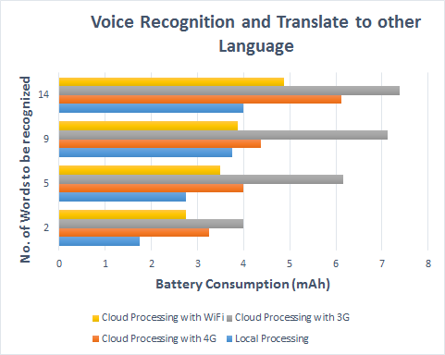
Applications: Voice Recognition
(Google Translate, Microsoft Translator etc.)

Slide 10
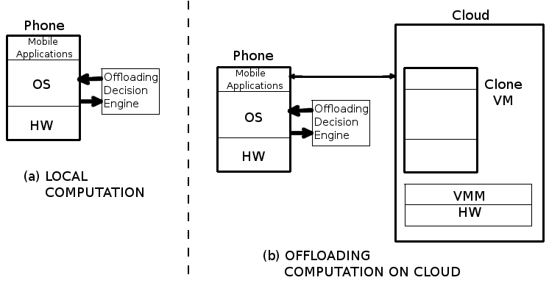
Offloading Vs Local Computation
The potential of code offloading lies in the ability to sustain power hungry applications by identifying
and managing energy consuming resources of the mobile device by offloading them onto cloud.

Slide 11
Related Work:
what code to offload (e.g., method name); when to offload (e.g., round-trip times thresholds); where to offload (e.g., type of cloud server); how to offload (e.g., split code into n processes)
Offloading Decision Engines:
Fuzzy Logic Decision Engine: Adaptive code offloading for mobile cloud applications: Exploiting fuzzy sets and evidence-based learning
Cuckoo: a computation offloading framework for smartphones (They propose a dynamic runtime system, that can, at runtime, decide whether a part of an application will be executed locally or remotely. Cuckoo offloading mechanism takes the offloading decision based on the server availability only, without considering other contextual information.)
Smartphone Energizer (SE): a supervised learning-based technique for energy efficient computation offloading. In this work authors propose a adaptive, and context-aware offloading technique that uses Support Vector Regression (SVR)

Slide 12
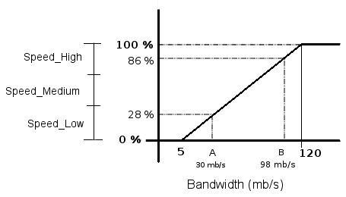
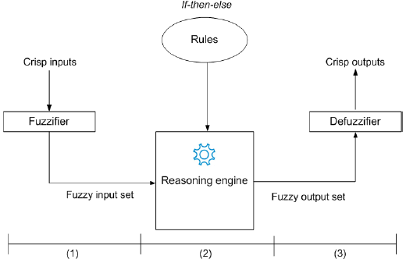
Fuzzy Logic Decision Engine
Fuzzy sets considered:
Bandwidth = Speed_Low, Speed_Normal, Speed_High
Wi-Fi = available, not_available
Data transferred = Data_Small, Data_Medium, Data_Big
CPU instance = CPU_Low, CPU_Normal, CPU_High
Rules considered:
Remote Processing = Speed_High AND Data_Small AND CPU_Normal
Local Processing = Speed_Low AND Data_Small AND CPU_High
Remote Processing = Speed_Normal AND Data_Small AND CPU_High
Local Processing = Speed_High AND Data_Small AND CPU_Low
Local Processing = Speed_Low AND Data_Medium AND CPU_Normal
Offload on Local Servers = Remote Processing AND WiFi ON
Offload on Remote Servers = Remote Processing AND WiFi OFF

Slide 13
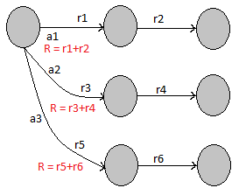

Reinforcement Learning -I
Reinforcement learning is learning by interacting with an environment.
The basic reinforcement learning model consists of:
a set of environment states S;
a set of actions A;
rules of transitioning between states;
rules that determine the scalar immediate reward of a transition

Slide 14
Reinforcement Learning -II
State Values
Bandwidth = Speed Low, Speed Normal, Speed High
WiFi = available, not available
Data transferred = Data Small, Data Medium, Data Big
CPU instance = CPU Low, CPU Normal, CPU High
Location = Home, Office, Traveling
Time = Morning, Afternoon, Night
Action Values
We need to train our Q function in all above mentioned conditions. In each such instance our smartphone
will have three actions to choose from which are
Local Processing
Offload on Local Servers
Offload on Remote Servers
The Agent-Environment Interaction Loop
For our agent to interact with its world, we implement the following steps:
1. Initialize Q (All the Reinforcement values are set to Zero)
2. Whenever the device changes its state (defined values in the state)
Run the application processing Locally and Record Reinforcement Values
Run the processing On Local Servers and Record Reinforcement Values
Run the application processing on Remote Cloud and Record Reinforcement Values

Slide 15
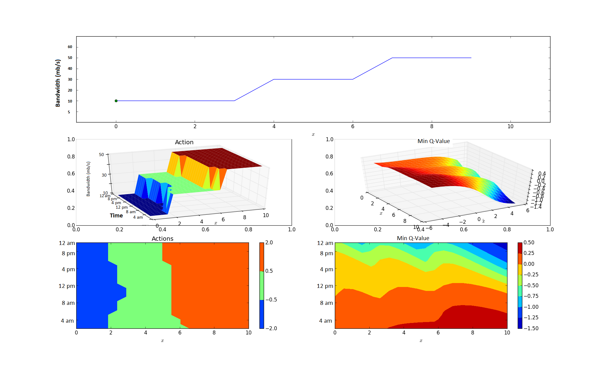
Reinforcement Learning with Neural-Net
For these set of results I have customized my Neural Network with no. of hidden layers as
(nh) = 5, run for trials (nTrials) = 100 and Steps per trial (nStepsPerTrial) = 10
To slowly transition from taking random actions to taking the action currently believed to be best,
called the greedy action, we slowly decay a parameter, ϵ, from 1 down towards 0 as the probability of
selecting a random action.
Offload On Remote
Cloud Servers
Offload on
Local Servers
Local Processing

Slide 16
Choosing between 3G, 4G and WiFi for Computation Offloading
State-Action Value Function
The state-action value function is a function of both state and action and its value is a prediction of the expected sum of future reinforcements.
Set of State Values
Location = Home, Office, Traveling
Data Transferred = Data Small, Data Medium, Data Large
Time = Morning, Afternoon, Evening, Night
The offloading system extracts the above parameters (such as Location, Time) from the contextual information of the Smartphone device.
Set of Action Values
Offload using 3G
Offload using 4G
Offload using Wi-Fi

Slide 17
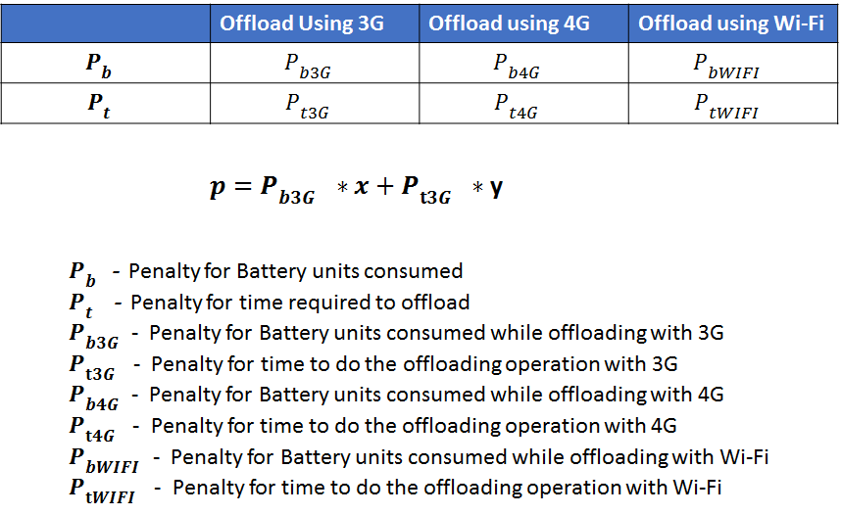
The values of constants are x = 0.5 and y = 0.5 for both optimized battery and performance time,
if user prefers better battery performance than elapsed processing time of the application then
we change the values to x = 0.9 and y = 0.1. (For example when the user is traveling he might prefer
to save his battery power than worrying about the processing time; whereas when the battery charge isn't a sudden
problem for the user then he might choose for optimized performance time,
in that case we need to change the constant value to x = 0.1 and y = 0.9

Slide 18

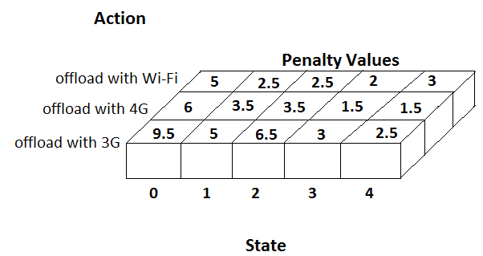
RL Algorithm:
Detect change in the Device's contextual information (Parameters such as Location (Home, Office, etc) and Time-Period (Morning, Afternoon, Evening and Night))
2. Activate 3G radio interface of the device.
3. Download a file (data size = data_small) from the AWS S3 Cloud. Measure the Battery and time consumed for the operation.
4. Upload same file on the cloud. Measure the Battery and time consumed for the operation.
5. Calculate the penalty p with the help of equation
6. form a Key-Value pair as follows:
{ Location-TimePeriod-data_size:penalty_value} where
Key = Location-TimePeriod-data size
Value = Calculated penalty p
7. Update the Q-table with the calculated penalty values as
shown in the figure
8. Repeat steps 2-7 above for
(data size = data_medium and data_large)
9. Repeat steps 2-8 above for 4G and Wi-Fi connection if available.

Slide 19
Smartphone Platforms and tools used
Smartphone Handsets Used:
Amazon Fire phone
Samsung S3
LG Nexus
Network:
AT & T's 3G, 4G Network
Comcast's WiFi Network
Other Tools:
Monsoon Power Measurement Tool
Android Device Bridge (ADB)
Amazon Web Services (AWS)
AWS Command Line Interface (CLI)

Slide 20
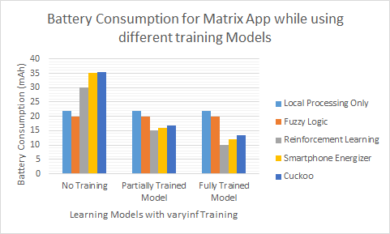

Slide 21
Current Status
Application Oriented Study of Offloading Framework
Fuzzy Logic Decision Engine
Reinforcement Learning for Optimal Offloading Decision
Reinforcement Learning with Neural Network
RL to choose between available networks (3G, 4G, and Wi-Fi)
Currently Working on Classification ML Algorithm to get Optimal Offloading Decision

Slide 22
References
K. Kumar and Y.H. Lu, “Cloud computing for mobile users: Can offloading computation save energy?,” Computer, vol. 43, no. 4, pp. 51-56, 2010.
H. Flores, P. Hui, S. Tarkoma, Y. Li, S. Srirama, and R. Buyya, “Mobile code offloading: from concept to practice and beyond,” Communications Magazine, IEEE, vol. 53, no. 3, pp. 80-88, 2015.
E. Cuervo, A. Balasubramanian, D. k. Cho, A. Wolman, S. Saroiu, R. Chandra, and P. Bahl, “Maui: making smartphones last longer with code offload,” in Proceedings of the 8th international conference on Mobile systems, applications, and services, pp. 49-62, ACM, 2010.
H. Flores and S. Srirama, “Mobile code offloading: should it be a local decision or global inference?," in Proceeding of the 11th annual international conference on Mobile systems, applications, and services, pp. 539-540, ACM, 2013.
A. Khairy, H. H. Ammar, and R. Bahgat, “Smartphone energizer: Extending smartphone's battery life with smart offloading,” in Wireless Communications and Mobile Computing Conference (IWCMC), 2013 9th International, pp. 329-336, IEEE, 2013.
I. Kelenyi and J. K. Nurminen, \Cloudtorrent-energy-ecient bittorrent content sharing for mobile devices via cloud services," in Proceedings of the 7th IEEE on Consumer Communications and Networking Conference (CCNC), vol. 1, 2010.

